Slide 1




$$x_{1}$$
$$\frac{∂f}{∂x_{0}}=\frac{f\left(3+h, 4\right)−f\left(3−h, 4\right)}{2h}$$
$${(x}_{0}=3,x_{1}=4)$$
$$x_{0}$$
x= (3, 4)
def numerical_gradient( f, x ):
h = 1e-4
grad = np.zeros_like(x)
for idx in range(x.size):
tmp_val = x[idx]
""" f(x+h) 계산 """
x[idx] = tmp_val + h
fxh1 = f(x)
""" f(x-h) 계산 """
x[idx] = tmp_val - h
fxh2 = f(x)
grad[idx] = (fxh1 - fxh2) / (2*h)
x[idx] = tmp_val # 값 복원

Slide 2
$$x_{1}$$
$$\frac{∂f}{∂x_{0}}=\frac{f\left(3+h, 4\right)−f\left(3−h, 4\right)}{2h}$$
$${(x}_{0}=3,x_{1}=4)$$
$$x_{0}$$
x= (3, 4)
grad= (0, 0)
def numerical_gradient( f, x ):
h = 1e-4
grad = np.zeros_like(x)
for idx in range(x.size):
tmp_val = x[idx]
""" f(x+h) 계산 """
x[idx] = tmp_val + h
fxh1 = f(x)
""" f(x-h) 계산 """
x[idx] = tmp_val - h
fxh2 = f(x)
grad[idx] = (fxh1 - fxh2) / (2*h)
x[idx] = tmp_val # 값 복원

Slide 3



$$x_{1}$$
$$\frac{∂f}{∂x_{0}}=\frac{f\left(3+h, 4\right)−f\left(3−h, 4\right)}{2h}$$
$${(x}_{0}=3,x_{1}=4)$$
$$x_{0}$$
x= (3, 4)
grad= (0, 0)
idx = 0
tmp_val = 3
def numerical_gradient( f, x ):
h = 1e-4
grad = np.zeros_like(x)
for idx in range(x.size):
tmp_val = x[idx]
""" f(x+h) 계산 """
x[idx] = tmp_val + h
fxh1 = f(x)
""" f(x-h) 계산 """
x[idx] = tmp_val - h
fxh2 = f(x)
grad[idx] = (fxh1 - fxh2) / (2*h)
x[idx] = tmp_val # 값 복원

Slide 4
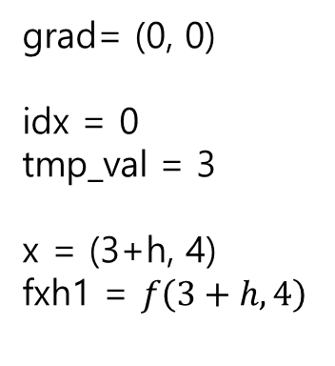
$$x_{1}$$
$$\frac{∂f}{∂x_{0}}=\frac{f\left(3+h, 4\right)−f\left(3−h, 4\right)}{2h}$$
$${(x}_{0}=3,x_{1}=4)$$
$$x_{0}$$
x= (3, 4)
grad= (0, 0)
idx = 0
tmp_val = 3
x = (3+h, 4)
fxh1 = $f\left(3+h, 4\right)$
def numerical_gradient( f, x ):
h = 1e-4
grad = np.zeros_like(x)
for idx in range(x.size):
tmp_val = x[idx]
""" f(x+h) 계산 """
x[idx] = tmp_val + h
fxh1 = f(x)
""" f(x-h) 계산 """
x[idx] = tmp_val - h
fxh2 = f(x)
grad[idx] = (fxh1 - fxh2) / (2*h)
x[idx] = tmp_val # 값 복원

Slide 5
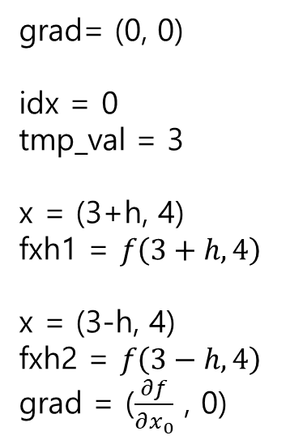
$$x_{1}$$
$$\frac{∂f}{∂x_{0}}=\frac{f\left(3+h, 4\right)−f\left(3−h, 4\right)}{2h}$$
$${(x}_{0}=3,x_{1}=4)$$
$$x_{0}$$
x= (3, 4)
grad= (0, 0)
idx = 0
tmp_val = 3
x = (3+h, 4)
fxh1 = $f\left(3+h, 4\right)$
x = (3-h, 4)
fxh2 = $f\left(3−h, 4\right)$
grad = ($\frac{∂f}{∂x_{0}}$ , 0)
def numerical_gradient( f, x ):
h = 1e-4
grad = np.zeros_like(x)
for idx in range(x.size):
tmp_val = x[idx]
""" f(x+h) 계산 """
x[idx] = tmp_val + h
fxh1 = f(x)
""" f(x-h) 계산 """
x[idx] = tmp_val - h
fxh2 = f(x)
grad[idx] = (fxh1 - fxh2) / (2*h)
x[idx] = tmp_val # 값 복원

Slide 6

$$x_{1}$$
$$\frac{∂f}{∂x_{1}}=\frac{f\left(3, 4+h\right)−f\left(3, 4−h\right)}{2h}$$
$${(x}_{0}=3,x_{1}=4)$$
$$x_{0}$$
x= (3, 4)
grad= (0, 0)
idx = 1
tmp_val = 4
def numerical_gradient( f, x ):
h = 1e-4
grad = np.zeros_like(x)
for idx in range(x.size):
tmp_val = x[idx]
""" f(x+h) 계산 """
x[idx] = tmp_val + h
fxh1 = f(x)
""" f(x-h) 계산 """
x[idx] = tmp_val - h
fxh2 = f(x)
grad[idx] = (fxh1 - fxh2) / (2*h)
x[idx] = tmp_val # 값 복원

Slide 7
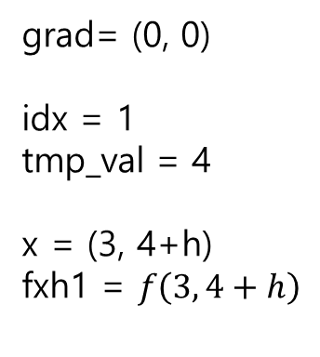
$$x_{1}$$
$$\frac{∂f}{∂x_{1}}=\frac{f\left(3, 4+h\right)−f\left(3, 4−h\right)}{2h}$$
$${(x}_{0}=3,x_{1}=4)$$
$$x_{0}$$
x= (3, 4)
grad= (0, 0)
idx = 1
tmp_val = 4
x = (3, 4+h)
fxh1 = $f\left(3, 4+h\right)$
def numerical_gradient( f, x ):
h = 1e-4
grad = np.zeros_like(x)
for idx in range(x.size):
tmp_val = x[idx]
""" f(x+h) 계산 """
x[idx] = tmp_val + h
fxh1 = f(x)
""" f(x-h) 계산 """
x[idx] = tmp_val - h
fxh2 = f(x)
grad[idx] = (fxh1 - fxh2) / (2*h)
x[idx] = tmp_val # 값 복원

Slide 8
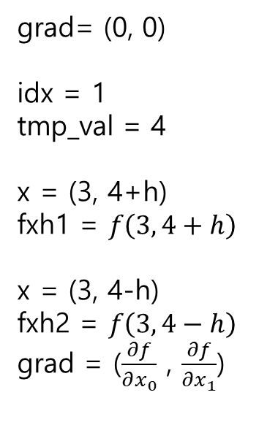
$$x_{1}$$
$$\frac{∂f}{∂x_{1}}=\frac{f\left(3, 4+h\right)−f\left(3, 4−h\right)}{2h}$$
$${(x}_{0}=3,x_{1}=4)$$
$$x_{0}$$
x= (3, 4)
grad= (0, 0)
idx = 1
tmp_val = 4
x = (3, 4+h)
fxh1 = $f\left(3, 4+h\right)$
x = (3, 4-h)
fxh2 = $f\left(3, 4−h\right)$
grad = ($\frac{∂f}{∂x_{0}}$ , $\frac{∂f}{∂x_{1}}$)
def numerical_gradient( f, x ):
h = 1e-4
grad = np.zeros_like(x)
for idx in range(x.size):
tmp_val = x[idx]
""" f(x+h) 계산 """
x[idx] = tmp_val + h
fxh1 = f(x)
""" f(x-h) 계산 """
x[idx] = tmp_val - h
fxh2 = f(x)
grad[idx] = (fxh1 - fxh2) / (2*h)
x[idx] = tmp_val # 값 복원

